Slide 1
AI Enabled Automatic Ticket Assignment
Submitted By
Disha Palan
Parita Desai
Gloria Kamal

Slide 2
Problem Statement
In any of the IT industry, incident management plays an important role in delivering quality and timely support to its customers across the globe.
The incidents are generally created by various stakeholders like end users, vendors, IT users, etc. They might not have right information as to which team the ticket should go to. Hence, to improve and retain customer satisfaction, it is very important that the ticket is assigned to the right group of people for faster and appropriate resolution. In many Organizations this is still a manual process. There are few problems with the manual process:
Manual assignment of incidents is time consuming
It requires human efforts
There may be mistakes due to human errors and resource consumption is carried out ineffectively because of the misaddressing
Manual assignment increases the response and resolution times which result in user satisfaction deterioration / poor customer service
L1 / L2 needs to spend time to review Standard Operating Procedures (SOPs) before assigning to Functional teams (Minimum 25–30% of incidents needs to be reviewed for SOPs before ticket assignment).
15 mins are being spent for SOP review for each incident. Minimum of 1 FTE effort needed only for incident assignment to L3 teams.
During the process of incident assignments by L1 / L2 teams to functional groups, there were multiple instances of incidents getting assigned to wrong functional groups.
Around 25% of Incidents are wrongly assigned to functional teams. Additional effort needed for Functional teams to re-assign to right functional groups
During this process, some of the incidents are in queue and not addressed timely resulting in poor customer service and loss of business.
Hence with the AI enabled ticketing tool we need to classify the tickets in the correct assignment group

Slide 3




Traditional approach
Customers, vendors, end users
Customer representative
Is your customer happy ? - Maybe
Minimum 25–30% of incidents needs to be reviewed for SOPs before ticket assignment
15 mins are being spent for SOP review for each incident. Minimum of 1 FTE effort needed only for incident assignment to L3 teams
Around 25% of Incidents are wrongly assigned to functional teams
During this process, some of the incidents are in queue and not addressed timely resulting in poor customer service and loss of business
AI ENABLED TICKETING TOOL COMES FOR RESCUE WITH ALL THE ABOVE PROBLEMS

Slide 4
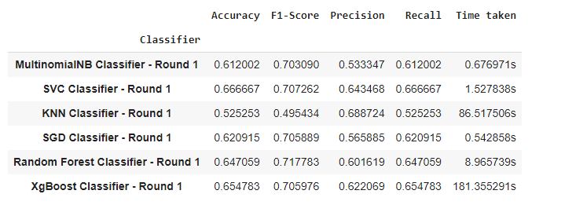
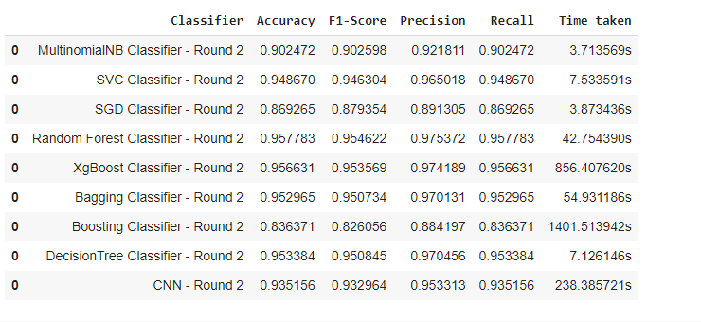
Solution
Below approach is taken to determine the assignment groups based on the ticket description and short description.
Exploratory data analysis
Visualized different patterns in the dataset and performed further analysis
Performed target column i.e. assignment group analysis
Dealt with inconsistencies like treating the missing values and merging the short description and long description to determine the assignment group for ticket
Text pre- processing done by fixing the encoding, detecting different languages and translating to English
Performed data cleaning by removing stop words, lemmatization and creating tokens
Performing Named Entity recognition and find POS tags for description
Modelling : Modelling was performed in two rounds:
Round I - Before treating class imbalance : Below Models are employed :
Round II - After treating class imbalance : Below Models are employed
Hyperparameter Tuning was done for above models
Transfer learning is employed with DISTILBERT with LinearSVC and Logistic regression with resampled data

Slide 5

Future approach with AI enabled tool
Customers, vendors, end users
AI ChatBot / software
Is your customer happy ? - Yes
Previous learning and training helps AI ticketing tool to find appropriate assignment groups
The incidents will be assigned to correct group and hence timely resolution is guaranteed
You save dollars because of less human errors and also less human intervention corresponds to requirement of small team size and less resources
Your Customer is Happy ☺

Slide 6
Detailed Solution
Data
Exploratory Data Analysis
Generate EDA reports
Removing duplicates
Treating null values
Merging short description and description
Further Data Analysis
Word Cloud
N Gram analysis
Assignment Group analysis
Caller analysis
Word Cloud
Data Pre-processing
Fix Encoding
Detecting Language
Translation
Data Cleaning
Removal of stop words
Lemmatization
Data Preparation
Named Entity Recognition
POS Tagging
Label Encoding
TFIDF Vectorizer
GloVe Embeddings
Treating class imbalance
Modelling / Classifiers
Multinomial Naïve Bayes
SVM
KNN
SGD
Random Forest
XgBoost
Bagging
Boosting
Decision Tree
Stacking
CNN
LSTM
GRU
DISTILBERT
Hyperparameter Tuning
Ensemble Method
Model comparison charts
Model Evaluation Metrics
Accuracy
F1 score (Precision Recall )
Type I errors
Type II Errors
Loss

Slide 7
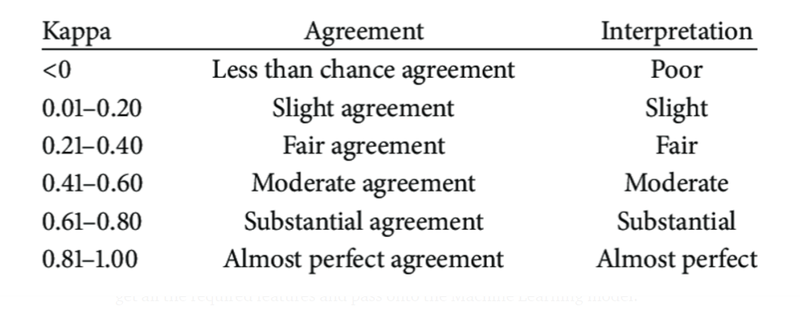
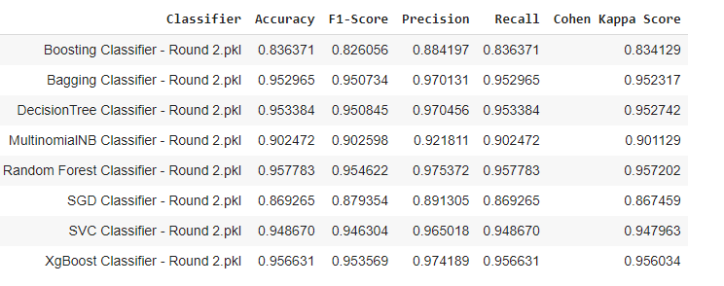
Models comparison to Benchmark
Cohen Kappa Benchmark
From above we see that the above classifiers based on the Cohen Kappa benchmark has an agreement of almost perfect and The interpretation is also almost perfect.

Slide 8
Improvement and Limitations

